Slide 1


Slide 2
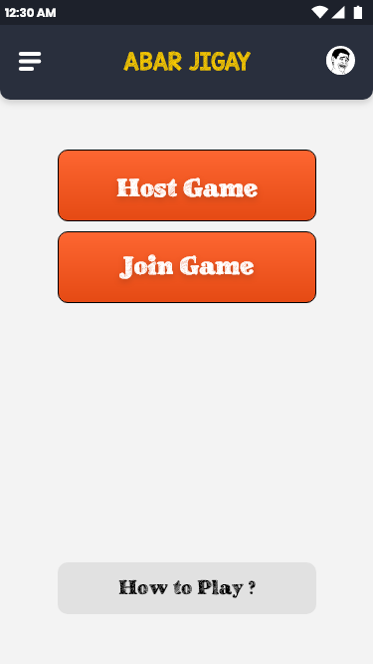
Fake it, Till you make it! Make Stay At Home fun this pandemic!
Play Abar Jigai, an exciting multiplayer game to play with your friends! Bluff your buddies with fake answers to real trivia questions in a variety of fun categories!

Slide 3

How to Play!
VIDEO GOES HERE

